Slide 1


TRIBHUVAN UNIVERSITY
Faculty of Humanities & Social Sciences
A Project Proposal
on
“Second Hand Buying and Selling ”
Presented by:
Mohammad Umar Akhtar
Yubraj Ghimire Khatri
BCA VI Semester

Slide 2
CONTENTS
Introduction
Problem Statement
Objectives
Methodology
Requirement Identification
Process Model
Feasibility Study
High Level design of the system(Working Mechanism, Algorithm)
Gantt Chart
Expected Outcome
References

Slide 3

INTRODUCTION
Second hand buying and selling products is a web-based application that is designed to sell and buy goods or materials which have been used or even new products.
This project aims to supply goods and materials for those who seek to buy desired products at a suitable and reasonable price.
This system has many facilities where users can buy goods that are included in the system category.

Slide 4
PROBLEM STATEMENT
Many platforms fail to consider users' evolving preferences, resulting in irrelevant content suggestions.
Users struggle to find desired products swiftly, causing dissatisfaction and wasted time.
Ineffective personalization leads to disengagement and loss of user interest over time.

Slide 5

OBJECTIVES
To provide easy and convenient transactions.
To maintain trust and security.

Slide 6
SCOPE
Security: Ensures safe and trustworthy transactions.
Sustainability: Promotes reusing items to reduce waste and encourage eco-friendly practices.

Slide 7
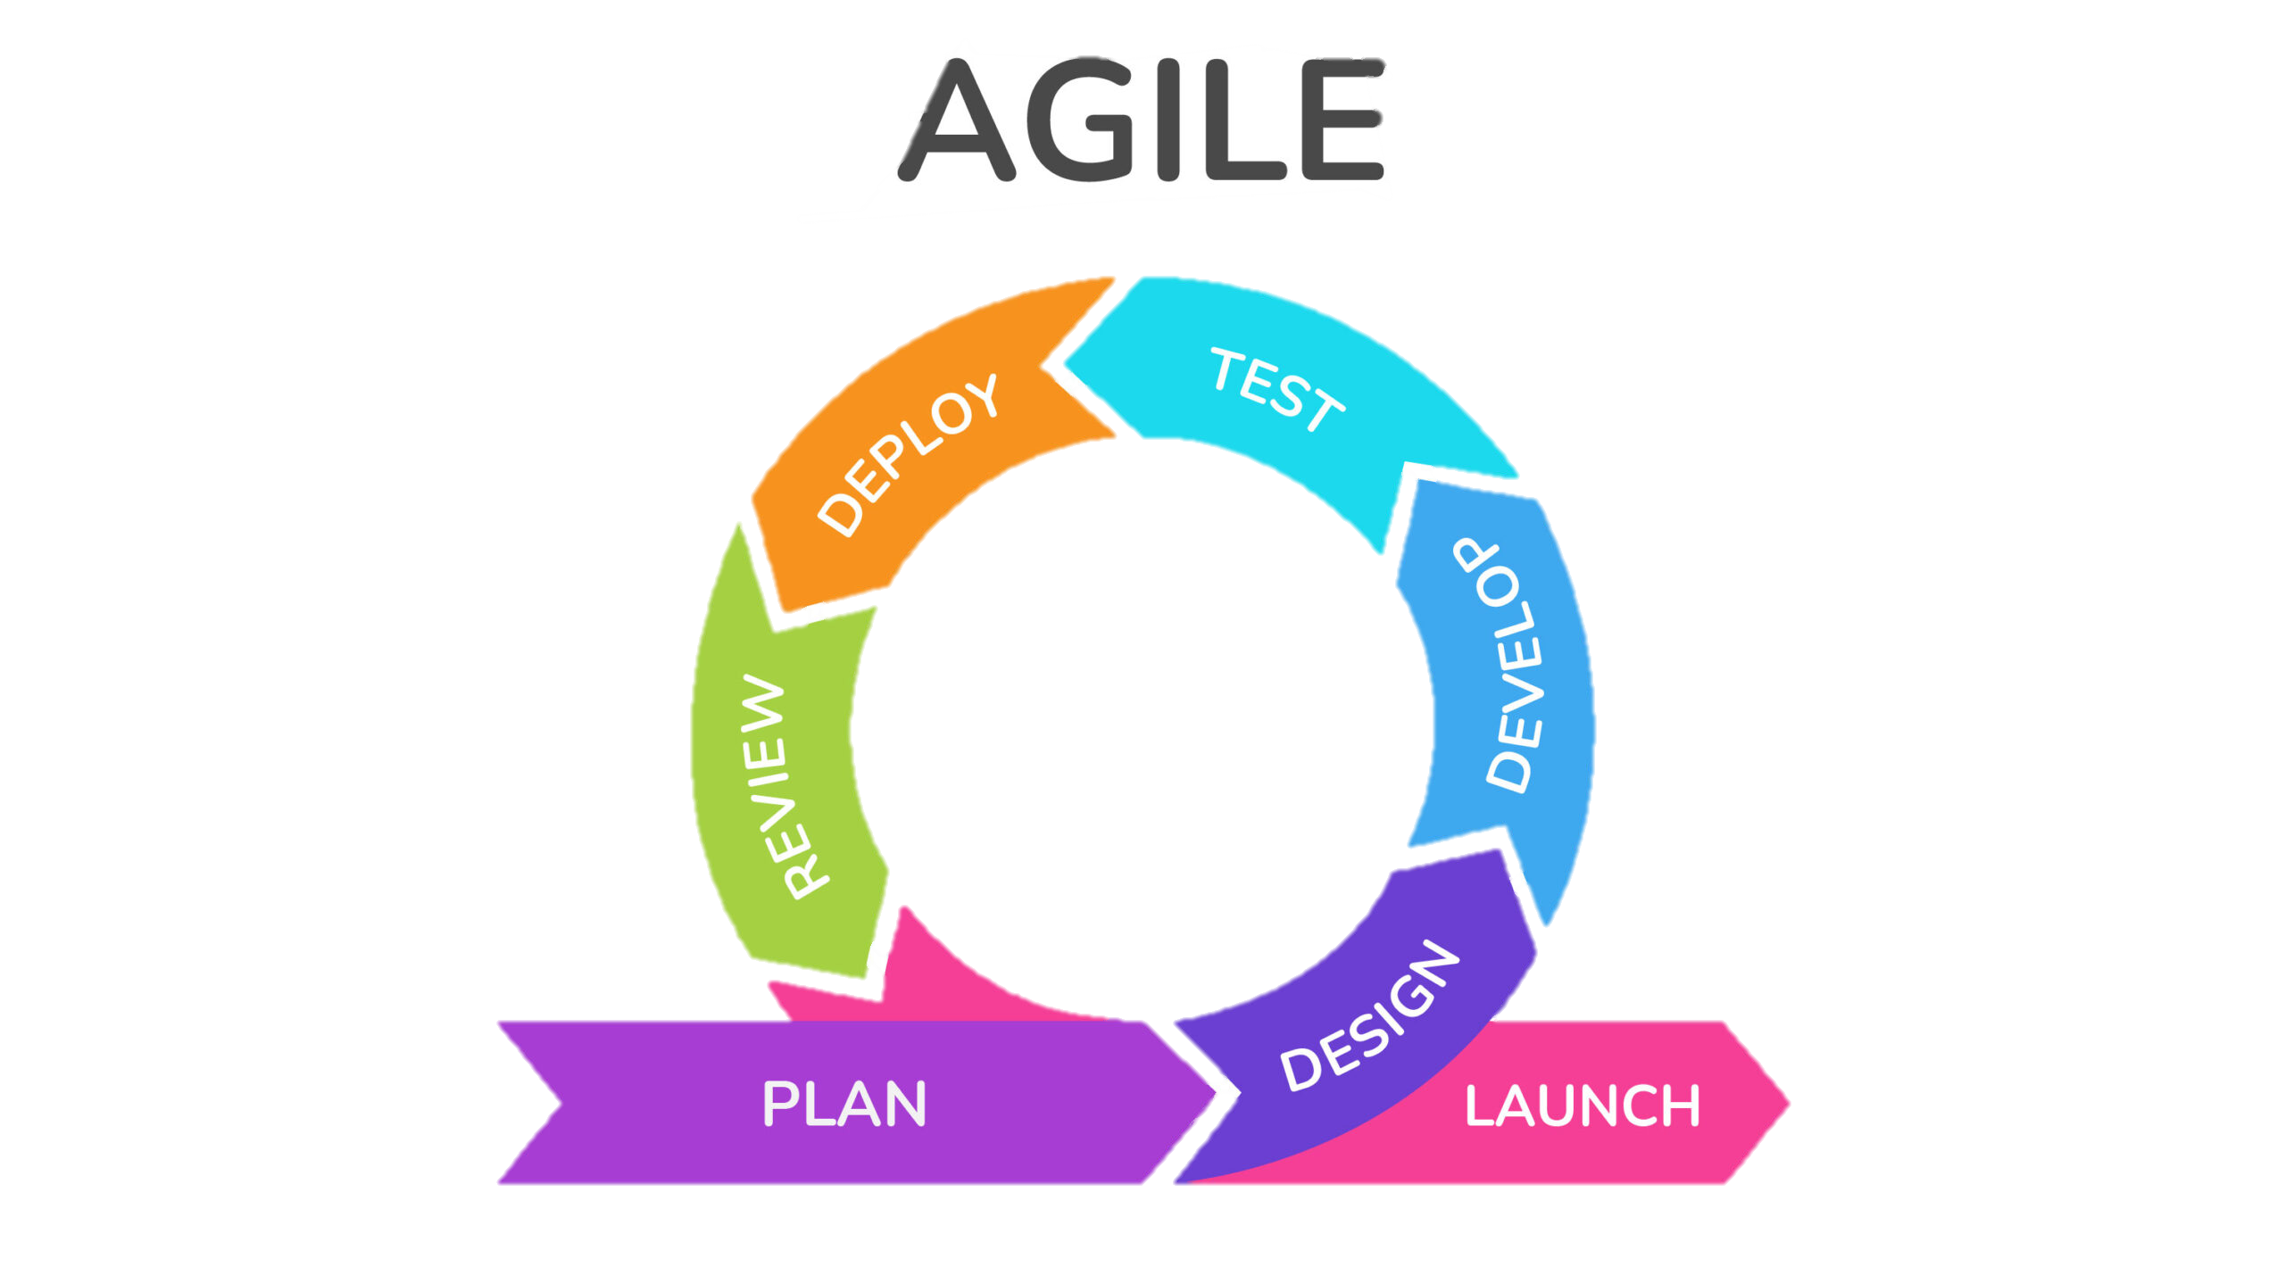
Process model
Agile methodology is a flexible and iterative approach to project management and software development. It emphasizes breaking projects into smaller, manageable phases called iterations or sprints. This allows teams to adapt to changes quickly, deliver value incrementally, and continuously improve based on feedback.

Slide 8

TOOLS FOR THE PROJECT
Frontend Tools
BACKEND
Tools
HTML
CSS
JavaScript
BOOTSTRAP
PHP (Server Side Scripting)
MYSQL (Database)
XAMPP (Local Server Solution)

Slide 9
Functional Requirement
User Registration & Login – Account creation, login, and profile management for buyers and sellers.
Product Listing – Sellers can list items with descriptions, images, and prices.
Search & Filter – Buyers can search and filter items by category, price, and condition.
Transaction Management – Secure buying, selling, and payment handling.
Ratings & Reviews – Users can rate and review transactions and sellers.

Slide 10
Non-Functional Requirement
Performance – The system should handle a large number of users and transactions simultaneously without lag.
Security – Ensure secure user data, including encrypted transactions and protection against fraud.
Scalability – The platform should be able to scale up as the number of users and items increases.
Usability – The system should have an intuitive interface, easy for both buyers and sellers to navigate.
Availability – The platform should be accessible 24/7 with minimal downtime.

Slide 11
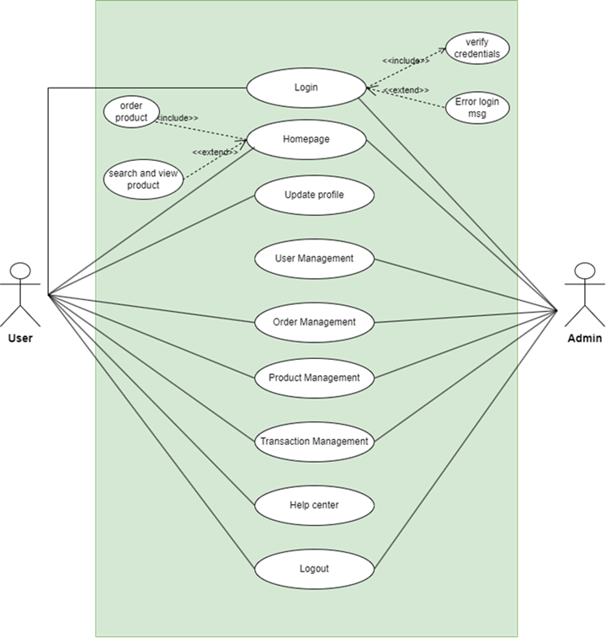
Use Case Diagram
Figure 1: System Flowchart

Slide 12
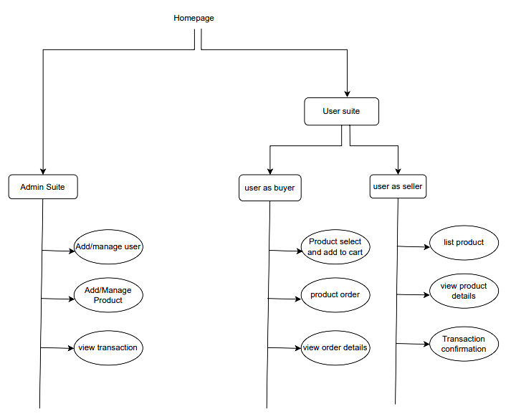
Architectural design

Slide 13
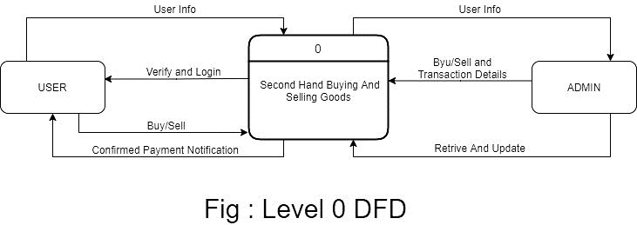
Dfd level 0
Figure : DFD level 0

Slide 14
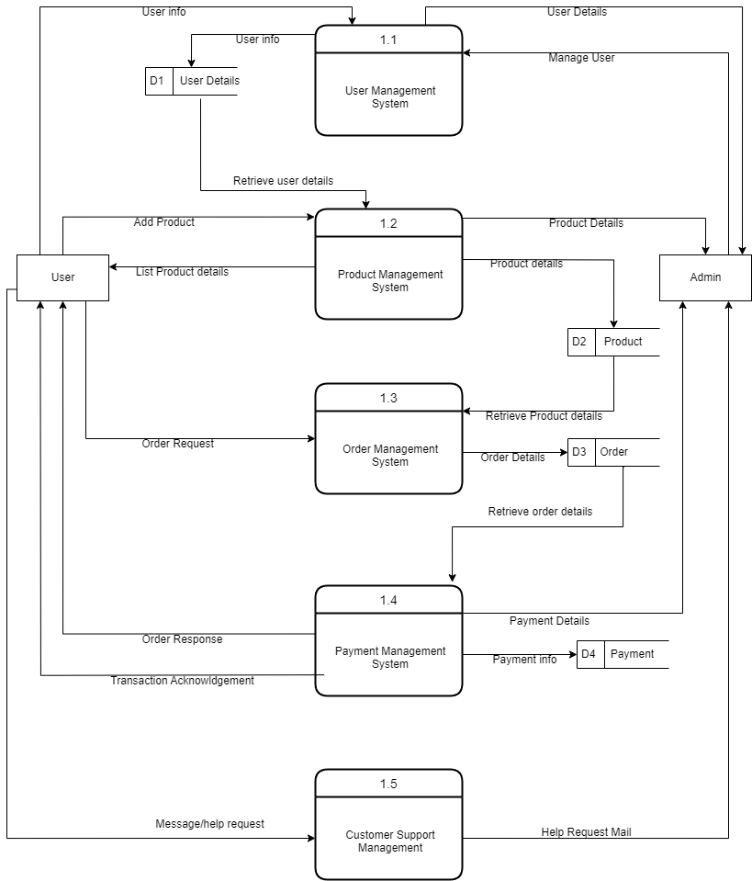
Dfd level 1
Figure : DFD level 1

Slide 15
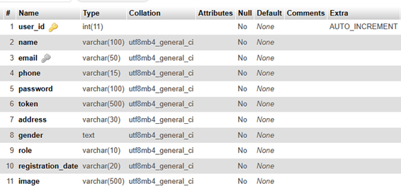
User details
Figure :User Details Database table

Slide 16
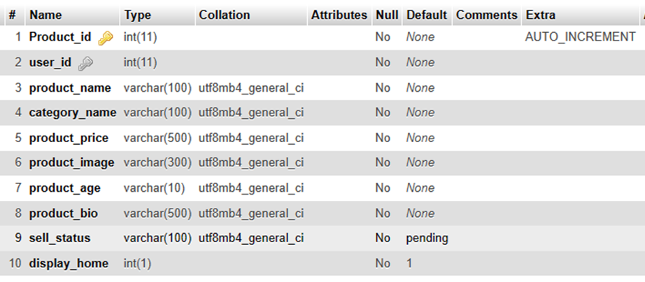
product details
Figure :Product Details Database table

Slide 17
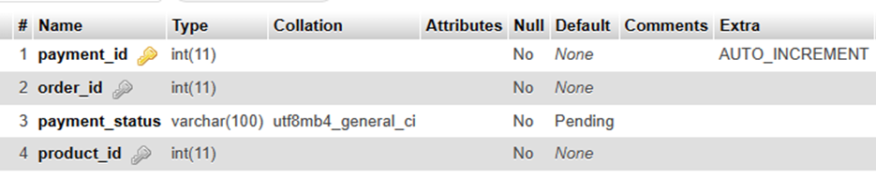
payment details
Figure :Payment Details Database table

Slide 18
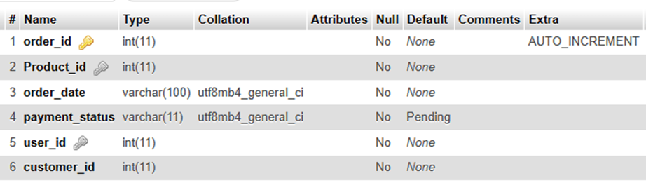
order details
Figure :Order Details Database table

Slide 19
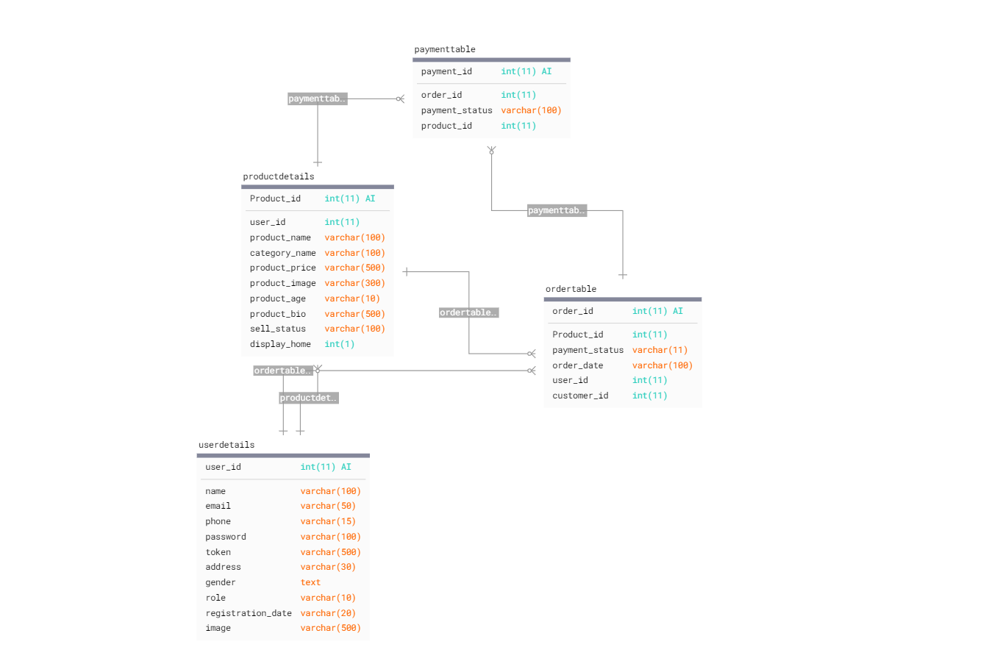
Database schema design

Slide 20
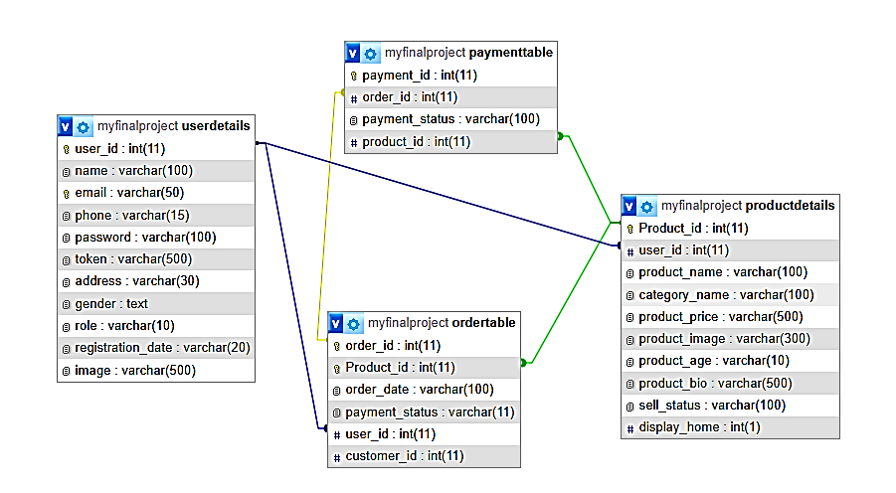
Database design

Slide 21
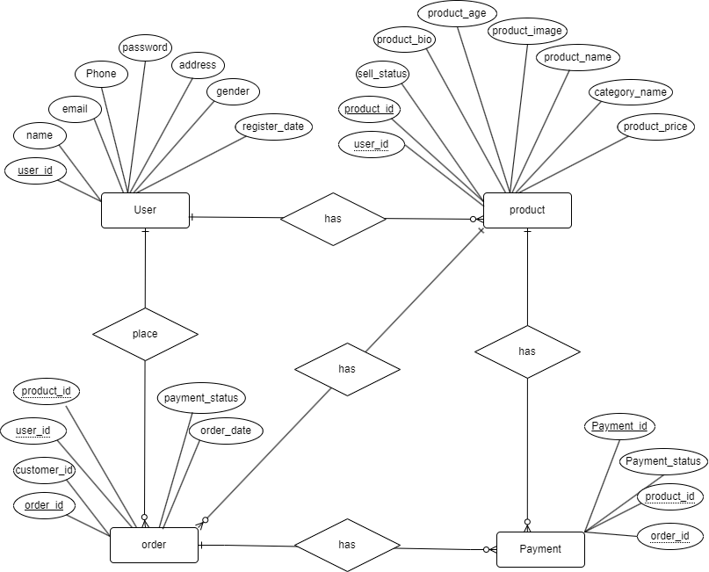
Er diagram

Slide 22

ALGORITHM
Collaborative Filtering: Analyzes user behavior to recommend products based on patterns among users or items.
User-Based Collaborative Filtering: Finds users with similar preferences by analyzing their past purchases or interactions. Suggests products liked by these similar users.
Item-Based Collaborative Filtering: Identifies relationships between products based on user ratings or actions. Recommends items similar to those a user has previously purchased or favorited.
Notes:
a) collaborative filtering relies on the collective behavior and opinions of users rather than item content or attributes.
b) “If User A and User B have similar preferences, and User B likes Item X, then recommend Item X to User A.”
c) “If a user liked Item A, and Item A is similar to Item B, recommend Item B to the user.”

Slide 23
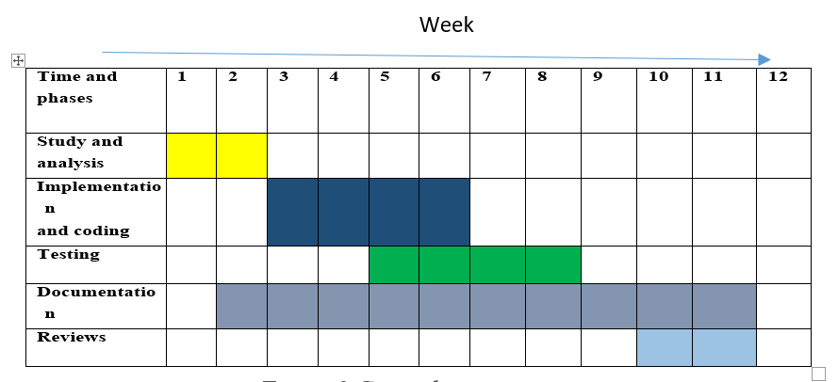
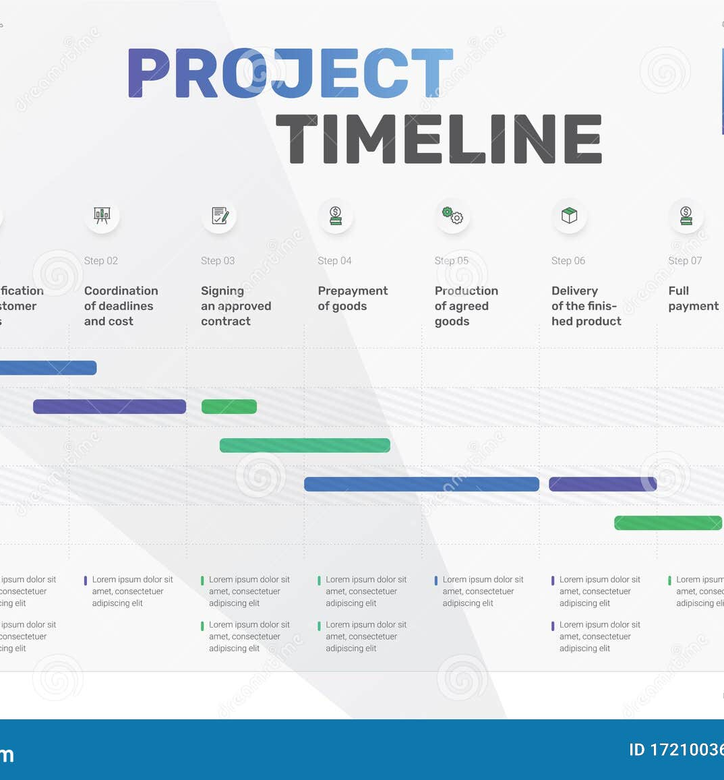
GANTT CHART

Slide 24

Expected Outcomes
Users get personalized product suggestions based on their preferences and browsing history.
The platform enhances user experience by making product discovery smooth and hassle-free.
Users benefit from quicker, more relevant item searches, saving time and effort.

Slide 25
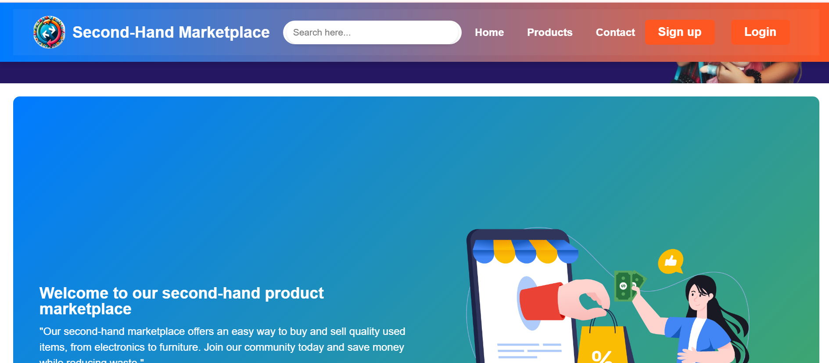
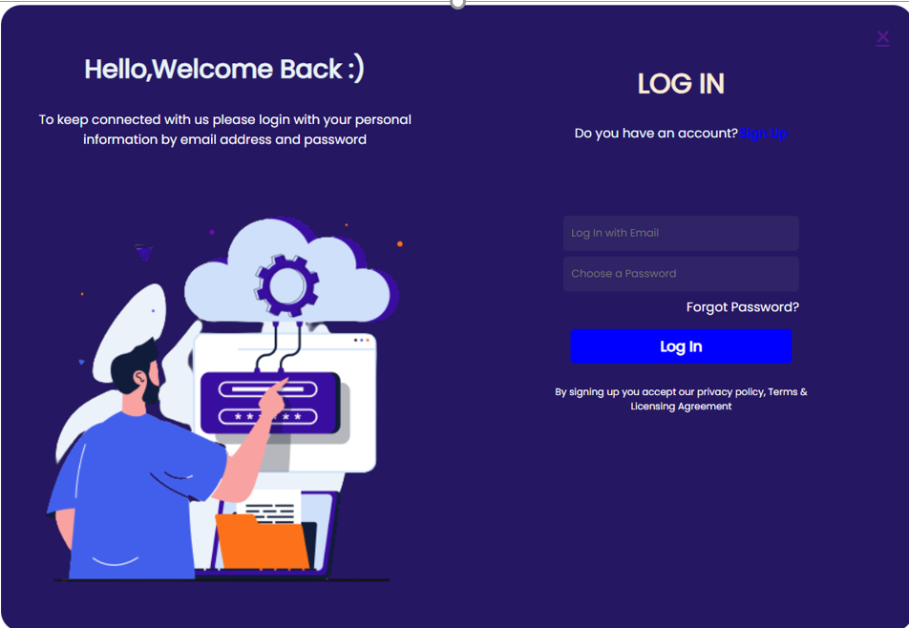
INTERFACE DESIGN

Slide 26
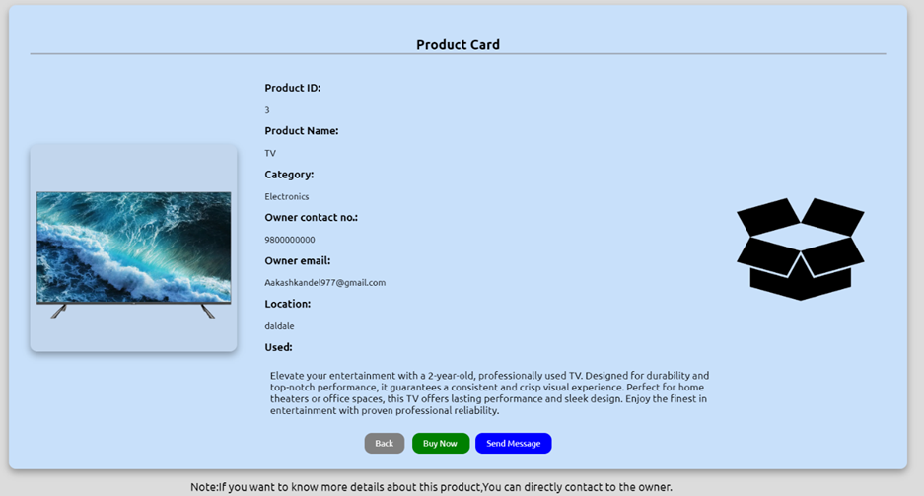

INTERFACE DESIGN

Slide 27
Dynamic delivery
Wang, X., & Zhang, Y. (2019). A Survey on Recommendation Systems for E-Commerce Platforms. Journal of Computer Science and Technology, 34(1).
Burke, R. (2021). Hybrid Recommender Systems: Survey and Experiments. User Modeling and User-Adapted Interaction, 31(4).
Aggarwal, C. C. (2016). Recommender Systems: The Textbook. Springer.

Slide 28
Thank you

